Slide 1
Prudent Management Associates
New Client Portal

Slide 2
Overall
Looks a lot like the existing site
Adds one extra level of security
Adds two new features
Export current data to CSV files
Download PDF versions of reports

Slide 3
What does a client see the first time they log into the new system?
Slightly different URL:
https://secure.prudentmanagementassociates/secure/login
The first screen is the same:
Username and password
What’s new is the next screen they will see.
Choosing some security questions and providing answers

Slide 4
Choose Three Questions
In what city were you born?
What is the last name of your favorite author?
What is your Mother's middle name?
What is your Father's middle name?
What's your favorite car?
What's your pet's name?
What's your favorite film?
What's your favorite team?

Slide 5
What are these for?
Each time they log-in they will be asked one of these three questions.
What about the “remember me” check box?
If they select this box a “cookie” will be put on that computer and that PC will be recognized for the next 60 days and therefore no need to be asked the security question.

Slide 6
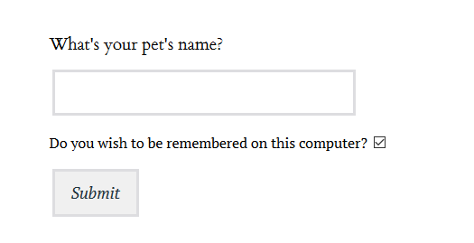
Challenge Screen

Slide 7
What happens if they do not answer the questions correctly?
They will see a big red box telling them to try again.

Slide 8
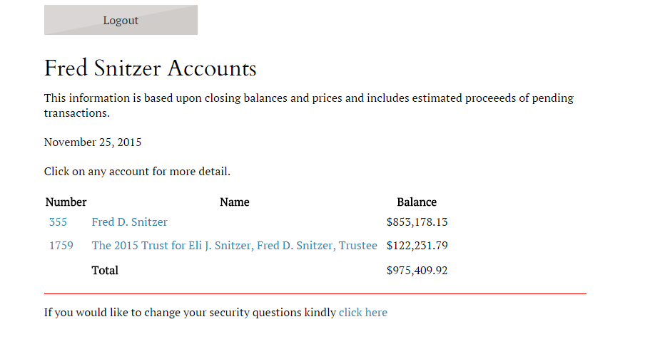
If the client has access to more than one account what will they see?
A summary page, similar to the current system, that shows totals for all the related accounts.

Slide 9
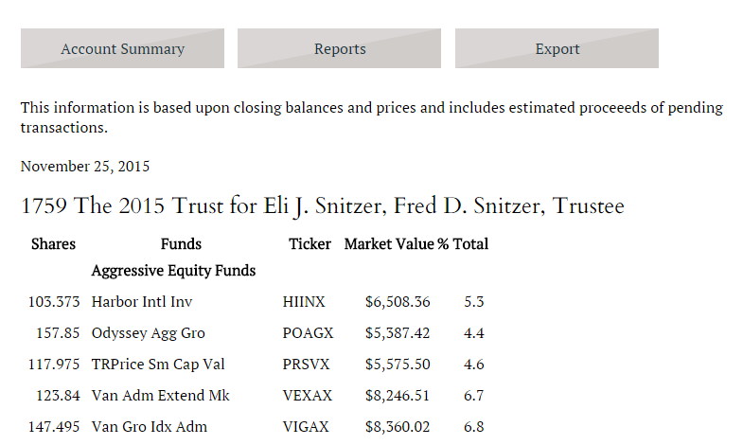
Account Detail

Slide 10
What does “export” mean?
This creates a CSV file of the currently displayed account
Can be imported into Excel or Google Docs

Slide 11
What does a PDF report look like?
See sample handout

Slide 12
How do we add a new client?
Using the existing VB system create the username and password
During a batch job that runs each night that data will be imported into the Web Portal system.
Removals happen the same way

Slide 13
How do I reset a client’s questions and answers?
Remove that client’s data from the “ClientAnswer” table in the PMAMaster database

Slide 14
How do I reset a client’s password?
Use the existing VB system and wait for the overnight process.
If you must look for the “WebClient” table in the PMAMASTER database and manually edit the data.

Slide 15
How do I clear a client’s cookies?
You cannot. Only the client on their browser can do that.
Each browser has its own way of doing this

Slide 16
DEMO
Questions?

